Slide 1
Internal Architecture
Of
8086 Microprocessor
Department of Computer Science & Engineering BRAC University.
Course ID: CSE - 341
Course Title: Microprocessors

Slide 2
Lecture References:
Book:
Microprocessors and Interfacing: Programming and Hardware, Chapter # 2, Author: Douglas V. Hall
CSE – 341 : Microprocessors
BRAC University

Slide 3
Organization of the 8086
Microprocessor 8086 is internally divided into two separate functional units. These are:
Bus Interface Unit (BIU)
Execution Unit (EU).
These two functional units can work simultaneously to increase system speed and hence the throughput.
Throughput is a measure of number of instructions executed per unit time.
These two units interact directly with each other through Internal Bus.
CSE – 341 : Microprocessors
BRAC University

Slide 4
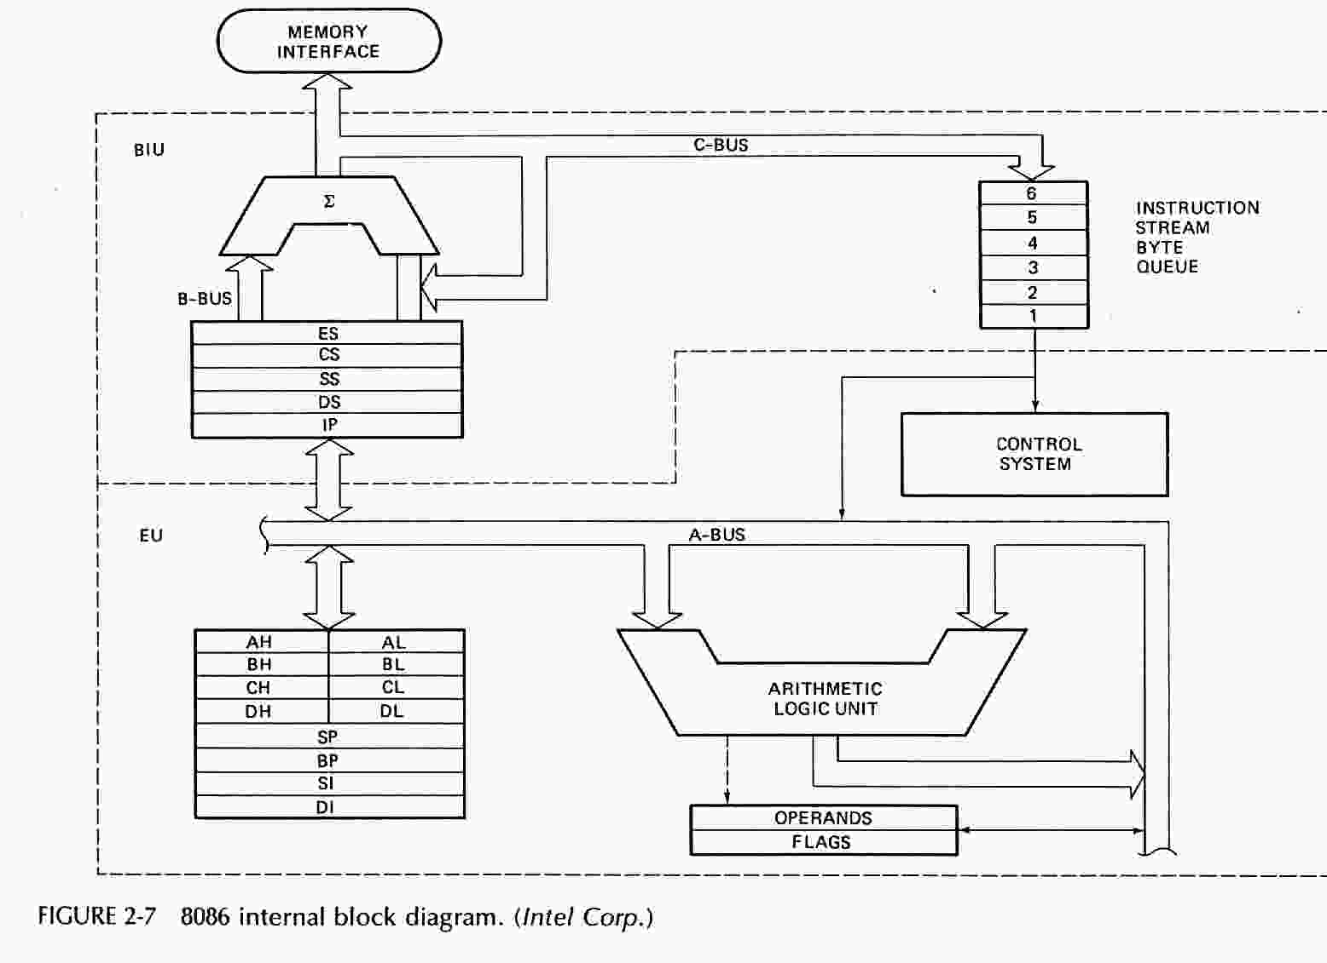
16-Bit 8086 Intel Processor Architecture
Physical address = segment no x 10h + offset
MOV AX,3H MOV BX,4H
ADD AX,BX
ADD AX, 2H
AX
ADD
BX
CSE – 341 : Microprocessors
BRAC University

Slide 5
Bus Interface Unit
BIU: facilitates communication between the EU & the memory or I/O circuits. It provides a full 16-bit bi-directional data bus and 20-bit address bus.
Responsible for transmitting addresses, data, and control signals on the buses.
Registers (CS, DS, ES, SS, and IP) hold addresses of memory locations.
IP (instruction pointer) contain the address of the next instruction to be executed by the EU.
CSE – 341 : Microprocessors
BRAC University

Slide 6
Bus Interface Unit
The bus interface unit is responsible for performing all external bus operations, as listed below.
It sends address of the memory or I/O.
It fetches instruction from memory.
It reads data from port/memory.
It Writes data into port/memory.
It supports instruction queuing.
It provides the address relocation facility.
CSE – 341 : Microprocessors
BRAC University

Slide 7
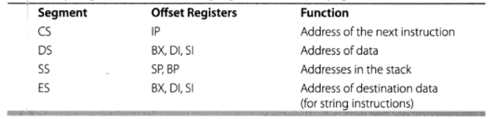
Physical Address Calculation in BIU
To generate 20 bit physical address Segment Registers (CS, DS, SS, ES) and Pointer and Index Registers (IP, SP, BP, SI, DI) are needed.
CSE – 341 : Microprocessors
BRAC University

Slide 8
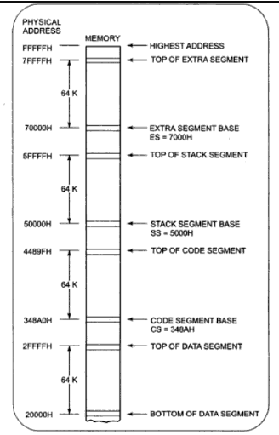
Memory Segment and Segment Registers
CSE – 341 : Microprocessors
BRAC University

Slide 9
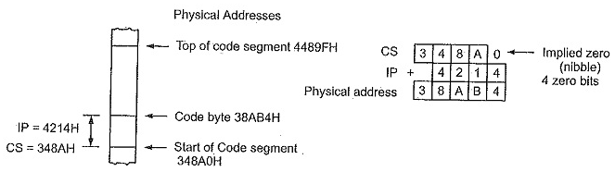
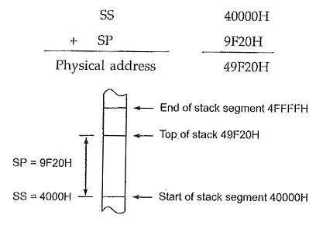
Physical Address Calculation Examples
CSE – 341 : Microprocessors
BRAC University

Slide 10
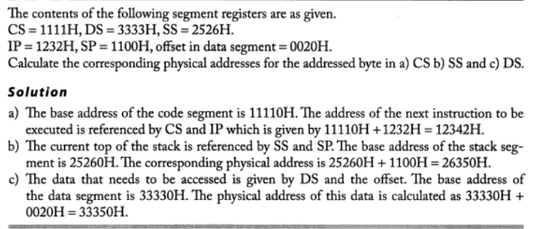
Physical Address Calculation Examples
CSE – 341 : Microprocessors
BRAC University

Slide 11
Instruction Queue
To speed up program execution, the BIU fetches six instruction bytes ahead of time from the memory.
These prefetched instruction bytes are held for the execution unit in a group of registers called Queue.
With the help of queue it is possible to fetch next instruction when current instruction is in execution.
The queue operates on the principle first in first out (FIFO). So that the execution unit gets the instructions for execution in the order they are fetched.
Exceptions: JUMP and CALL instructions
CSE – 341 : Microprocessors
BRAC University

Slide 12
Instruction Queue
38AB0
Current Instruction in EU
38AB1
IP
38AB2
38AB3
Instructions prefetched
in Queue
38AB4
38AB5
38AB6
49520
IP
CALL ADDITION
By JUMP or CALL
49521
49522
49523
CSE – 341 : Microprocessors
BRAC University

Slide 13
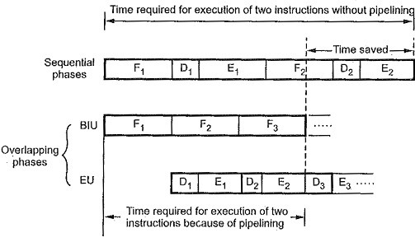
Instruction Queue
Fig: Pipelining
CSE – 341 : Microprocessors
BRAC University

Slide 14
Execution Unit (EU)
The execution unit of Internal Architecture of 8086 tells the BIU from where to fetch instructions or data, decodes instructions and executes instructions. It contains
Control Circuitry
Instruction Decoder
Arithmetic Logic Unit (ALU)
Flag Register
General Purpose Registers
Pointers and Index Registers
CSE – 341 : Microprocessors
BRAC University

Slide 15
Execution Unit (EU)
The main components of the EU are General purpose registers, the ALU, Special purpose registers, Instruction Register and Instruction Decoder and the Flag/Status Register.
Fetches instructions from the Queue in BIU, decodes and executes arithmetic and logic operations using the ALU.
Sends control signals for internal data transfer operations within the microprocessor.
Sends request signals to the BIU to access the external module.
It operates with respect to T-states (clock cycles) and not machine cycles.
CSE – 341 : Microprocessors
BRAC University

Slide 16
Arithmetic Logic Unit (ALU)
This unit performs all arithmetic and logical computations.
Instructions those are fetched and decoded, are executed in the ALU
Thus, ALU has direct access to General Purpose Registers and Flags.
CSE – 341 : Microprocessors
BRAC University

Slide 17
Temporary and Flag registers
Every processor has some temporary registers those are not visible to the programmers.
For these registers, our data are not lost in between different kinds of operations,
XCNG CX, BX
MOV temp, CX
MOV CX, BX
MOV BX, temp
FLAG Registers: A flag is a flip–flop which indicates some condition produced by the execution of an instruction or controls certain operations of the EU.
CSE – 341 : Microprocessors
BRAC University

Slide 18
Thank You !!
CSE – 341 : Microprocessors
BRAC University

